Slide 1
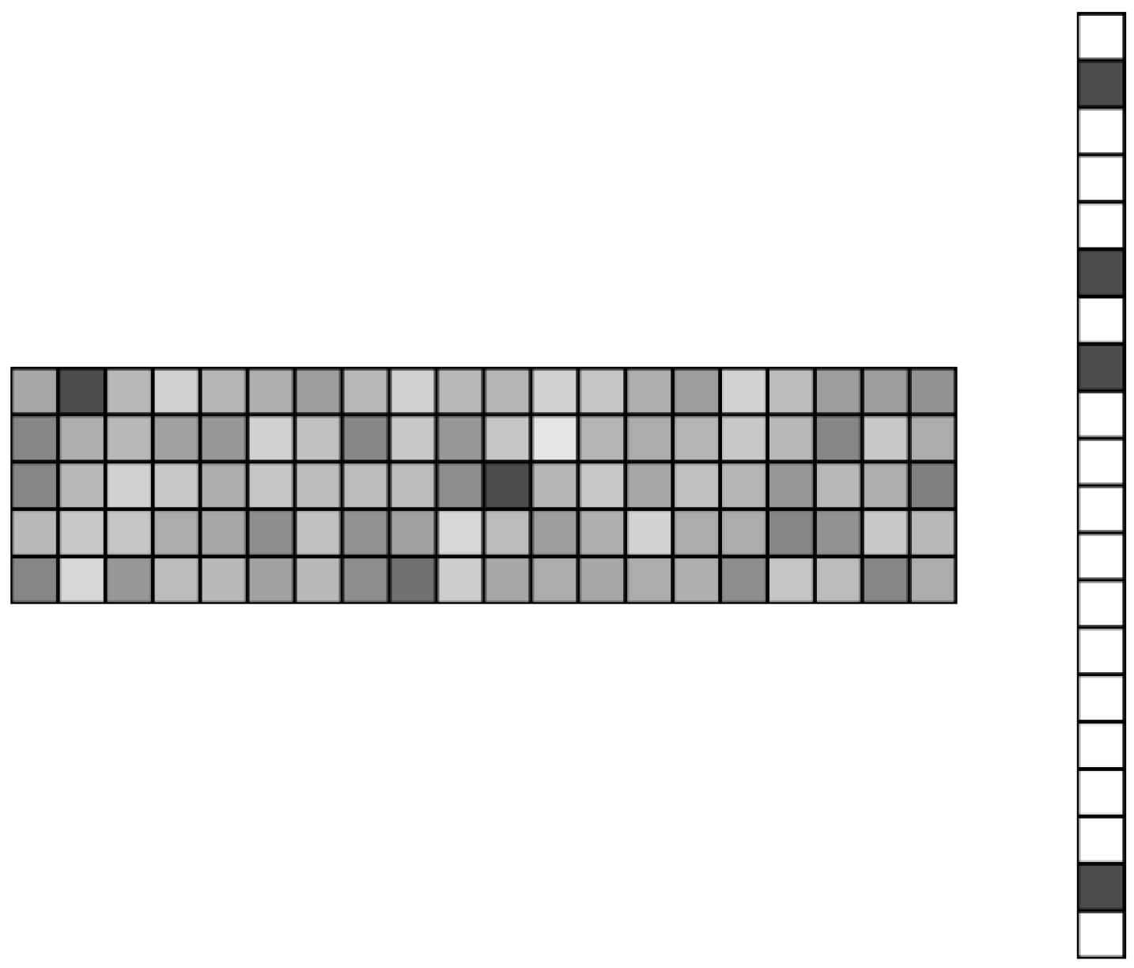
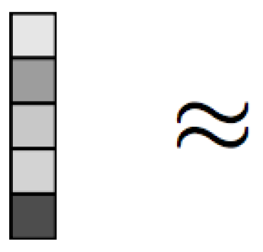
Project 1: Iterative Hard Thresholding in GWAS: Generalized Linear Models, Prior Weights, and Double Sparsity
Problem: Given dense , find sparse such that:
(inverse link function applied elementwise)
(response)
(design matrix)
(statistical model)
Figure: https://www.cs.cmu.edu/~ggordon/10725-F12/scribes/10725_Lecture2.pdf

Slide 2
IHT vs Lasso vs Marginal testing
 | Normal | Logistic | Poisson | Neg Binomial
IHT TF | 8.84 | 6.28 | 7.2 | 9.0
IHT FP | 0.02 | 0.1 | 1.28 | 0.98
Lasso TP | 9.52 | 8.16 | 9.28 | NA
Lasso FP | 31.26 | 45.76 | 102.24 | NA
Marginal TP | 7.18 | 5.76 | 9.04 (5.94*) | 5.98
Marginal FP | 0.06 | 0.02 | 1527.9 (0.0*) | 0.0
TP = true positives (higher means good)
FP = false positives (lower means good)
* = zero-inflated Poisson regression
Other methods for high dimensional GLM: Elastic net, MCP, Matching pursuit, stability selection, forward stepwise regression…
See our paper: https://www.biorxiv.org/content/10.1101/697755v1

Slide 3
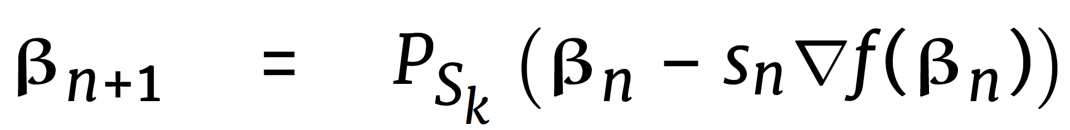

Bottleneck of IHT is gradient computation
IHT iterates according to:
5k by 30k SNP Matrix
Time spent on computing X^{t}v
Time spent on everything else
Question: Can mailman algorithm (which appears to require a lot of preprocessing) help us?

Slide 4
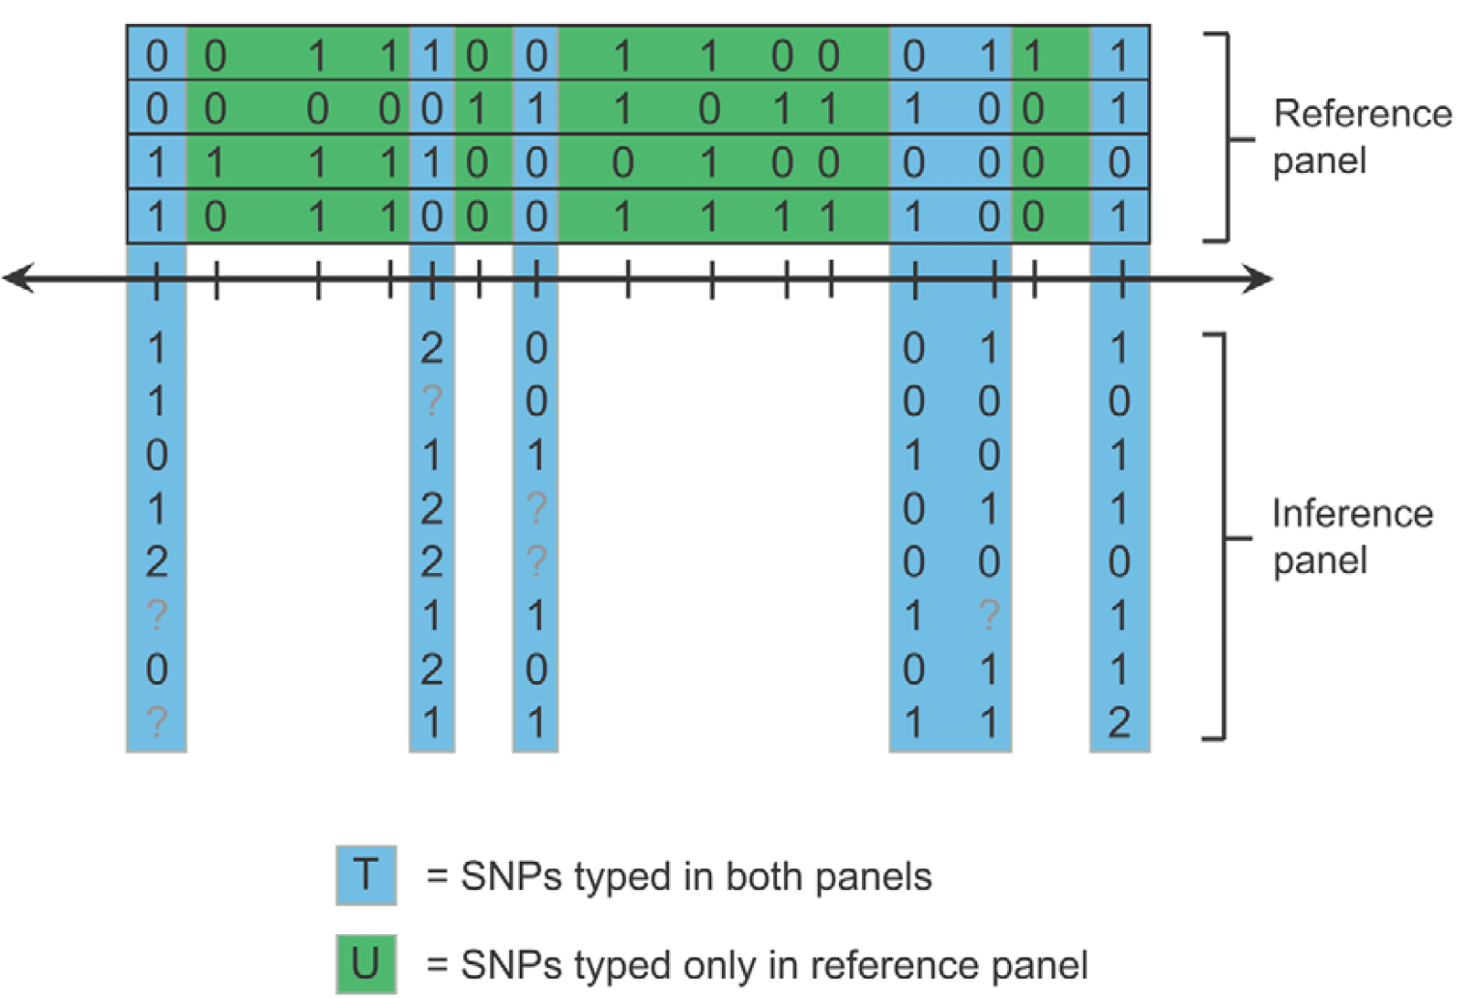
Project 2: Genotype imputation via haplotype reference panels
Problem: Fill missing entries of the inference panel
Figure: Howie, Bryan N., Peter Donnelly, and Jonathan Marchini. "A flexible and accurate genotype imputation method for the next generation of genome-wide association studies." PLoS genetics 5.6 (2009): e1000529.

Slide 5
Our method is based on least squares
Our competitors (Minimac4, Impute5, Beagle 5) all use Hidden Markov Models derived in (*)
Preliminary results:
Java
C++
Julia
 | Beagle 5.0 (phased) | Beagle 5.0 (unphased) | Minimac4 (phased) | MendelImpute (unphased)
Error rate (%) | 2.9 | 4.7 | 1.8 | 0.3
CPU time (sec) | 11 (+2525) | 1621 | 297 (+2525) | 5.4
36,498 SNPs, 660 reference panels, 665 samples as imputation target
Phasing data (beagle 4.1) adds 2525 seconds
MendelImpute does not require pre-phasing
Timing for MendelImpute does not include data import/export
(*) Li, Na, and Matthew Stephens. "Modeling linkage disequilibrium and identifying recombination hotspots using single-nucleotide polymorphism data." Genetics 165.4 (2003): 2213-2233.

